Slide 1
Online Application UI Settings
LEVEL - PRACTITIONER

Slide 2

Objectives
After completing this chapter, you will learn to:
  Explore User Interface Settings
  Search Features
  Customize Home Tab Page Layout
  Manage Translations

Slide 3

Overview
VEEVA CRM is a highly configurable application which follows the same configuration principles and utilizes the same configuration tools as Salesforce.com
Most of the VEEVA CRM application is configurable using the Salesforce.com Application and Administrative Setup functions
VEEVA CRM has some custom objects, fields and custom S-Controls which are configured and managed differently

Slide 4

Do You Know
The VEEVA CRM application leverages a combination of the Salesforce.com Setup configuration and custom VEEVA CRM specific functionality
The data that drives the user interface with respect to the labels and text that is displayed to the user is derived from two sources: The Salesforce.com Setup configuration and the VEEVA Message object
If an object leverages a custom VEEVA CRM user interface and there is no underlying Salesforce.com object, such as My Accounts and My Schedule
  Labels and text displayed are configured via VEEVA Message records
VEEVA users (Sales Rep, MSL, KAM) can search for their accounts
  based on many existing fields in CRM for iPad

Slide 5
Online Application UI Settings
Online Application User Interface Settings

Slide 6
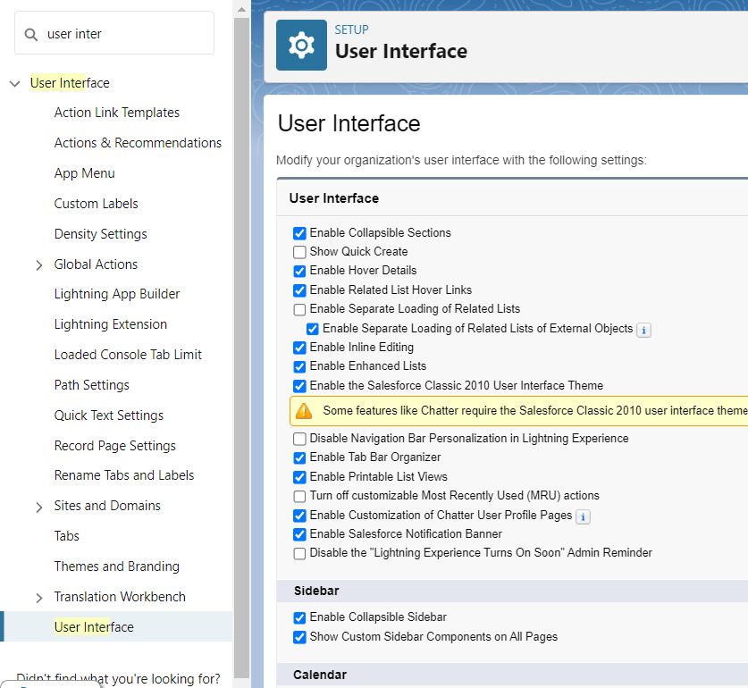
UI Settings
To access UI settings, go to –
  Setup > User Interface > User Interface
Enable or disable features by customizing user interface, like:
  Enable Collapsible Sections
  Show Quick Create
  Enable Hover Details
  Enable Related List Hover Links
  Enable Inline Editing
  Enable Printable List Views
  Enable the Salesforce Classic 2010 User Interface Theme
Note:
  Change in UI Settings only apply to online application (not iRep or vMobile Tablet)

Slide 7
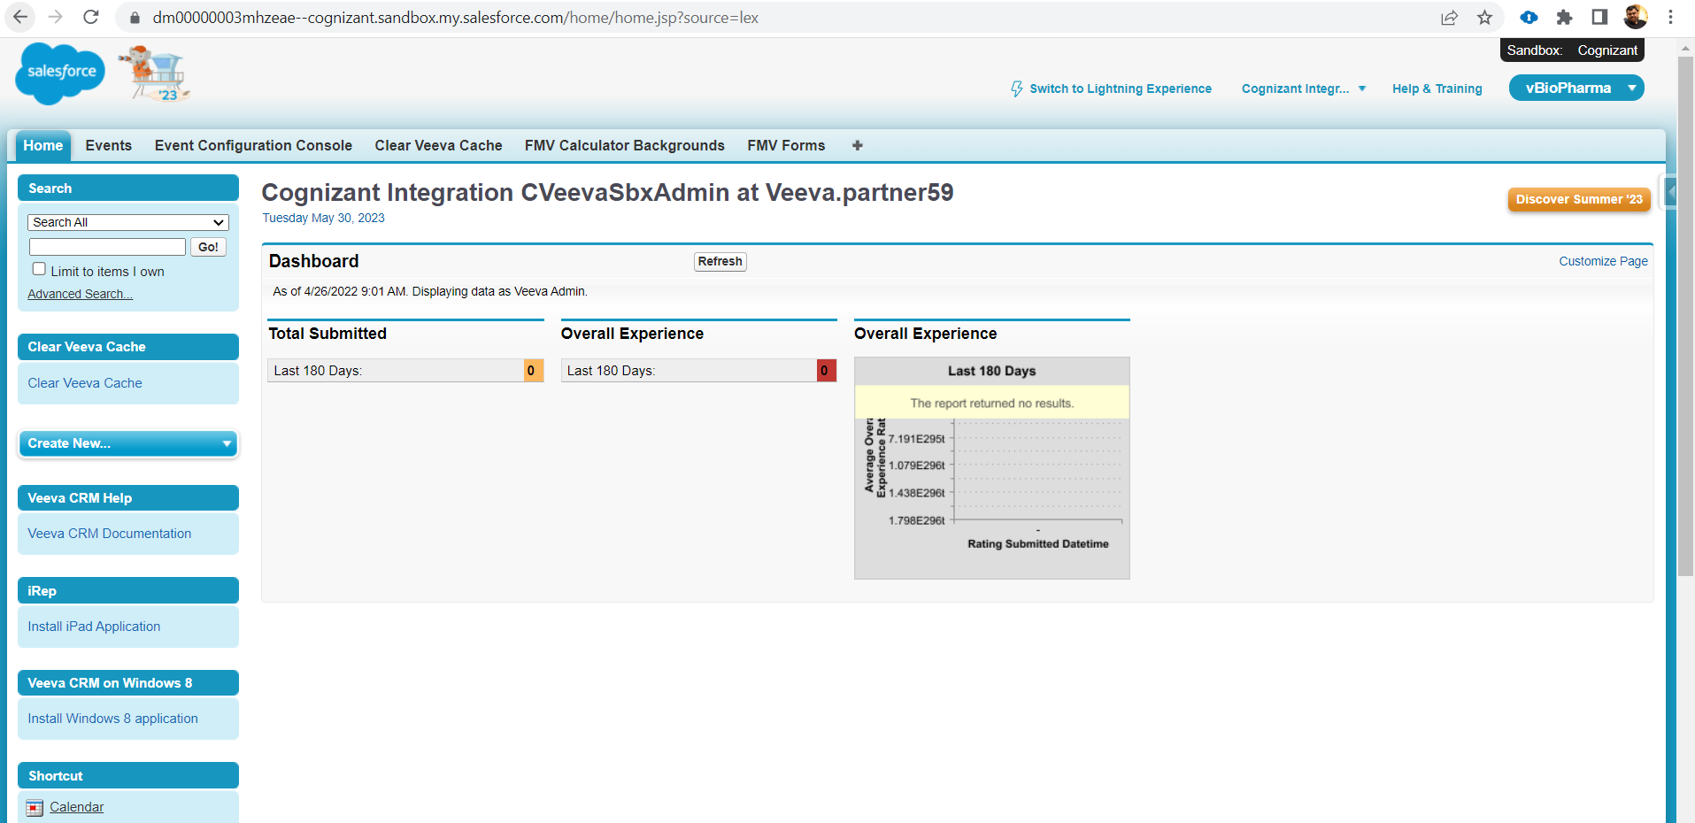
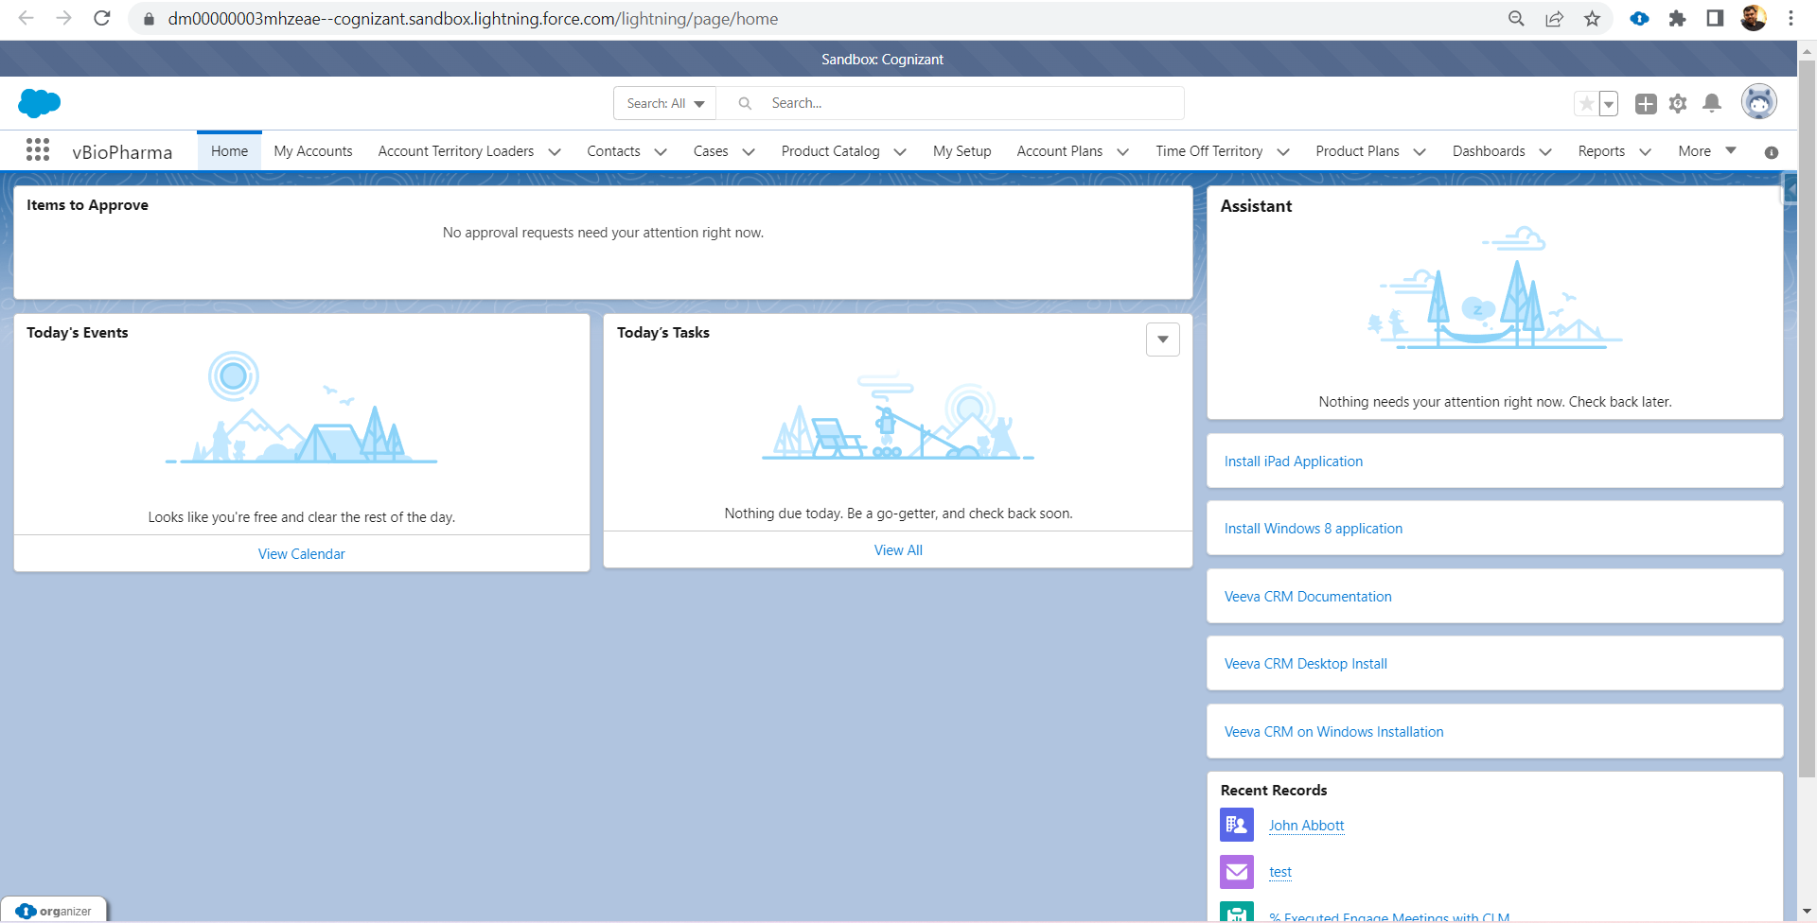
Enable New Interface Theme
  Interface themes:
    VEEVA CRM online supports both the Classic 2010 and new Salesforce User Interface themes
    The user interface theme can be configured by going to:
      Setup > Customize > User Interface
    To enable the updated UI:
      Select the ‘Enable the Salesforce Classic 2010 User Interface Theme’ option in the User Interface section
    Note:
      VEEVA recommends enabling new interface so that users can benefit from the full array of functionality that comes with it
      The user interface theme selected does not affect the functionality in VEEVA CRM online
C
L
A
S
SIC
LIGHTNING

Slide 8
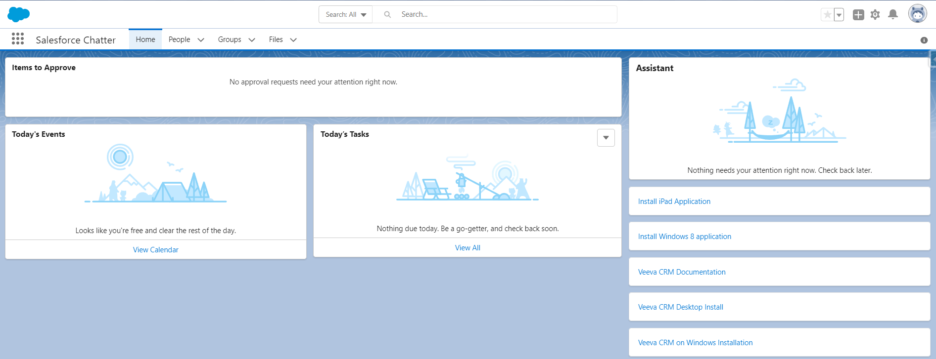
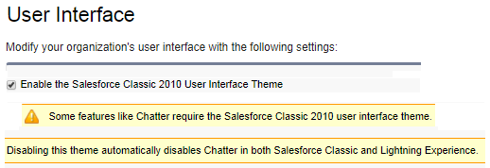
Chatter
  Turn on Chatter by going to:
    Setup > Customize > Chatter > Settings > Enable
    Chatter requires the Salesforce Classic 2010 user interface theme
    Disabling this theme automatically disables Chatter in both Salesforce Classic and Lightning Experience

Slide 9
Online Application UI Settings
Home Tab Page Layout

Slide 10
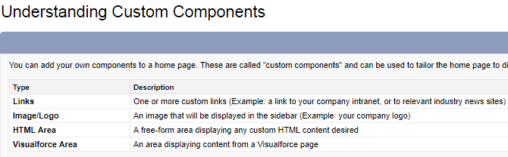
Key Considerations & Custom Components
  Key Considerations:
    Create Home tab components when needed
    Customize Home tab page layouts to include one or more of these components:
      Custom Links
      Sidebar Links
      Dashboard Snapshot
      Items to Approve
    Assign different Home tab page layouts to different profiles
    NOTE:
      Home Tab Configuration only apply to online application (not iRep or vMobile Tablet)
  Create Home Tab Components:
    Navigate to:
      Setup > Customize > Home > Home Page Components
    Click on the Edit link for the modifiable standard components:
      Messages and Alerts
      Custom Links
      Click the New button to define custom components

Slide 11
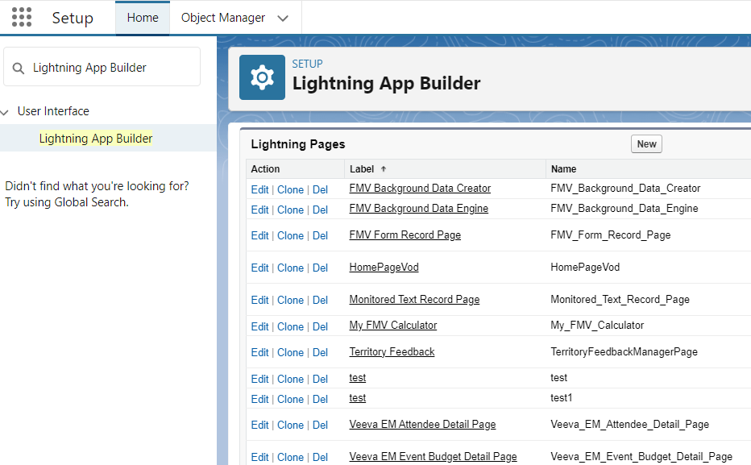
Customize Home Tab Page Layouts
Steps to Customize Home Tab page:
  Configure Home tab page layouts after creating the custom components
  Go to:
    Setup > Customize > Home > Home Page Layout
    Select the components to display on the Home tab
  Assign different Home tab page layouts to different profiles
  Arrange the order of the components on both on the narrow and wide sides of a Home tab page layout

Slide 12
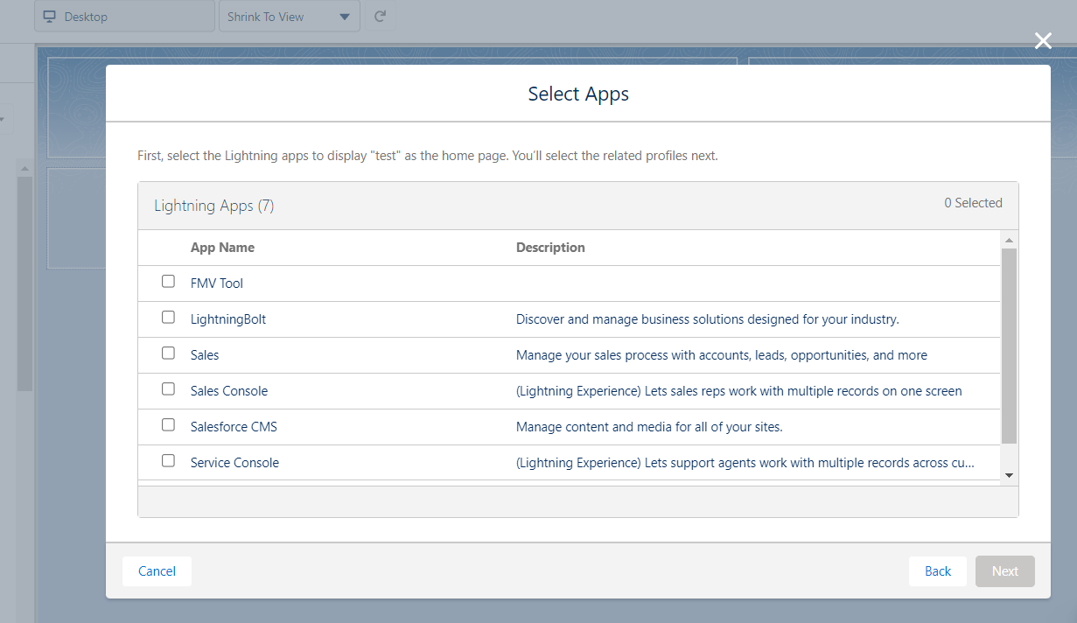
Assign Home Tab Page Layouts
To assign home tab page layouts to user profiles:
  Setup > Lightning App Builder
  Click the App and Profile button > Click the Assign to App and Profile button
    Note:
      Select home tab page layouts by profile

Slide 13
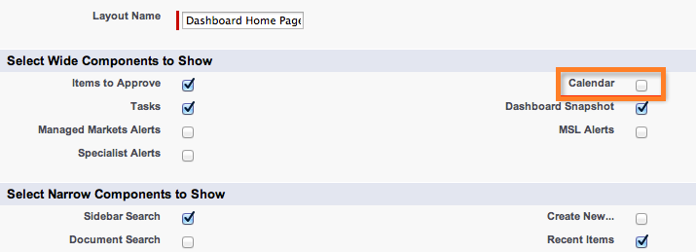
SFDC Calendar
  Best Practice:
    VEEVA Admins should choose not to display the Force.com Calendar, as it typically causes confusion with the VEEVA scheduling functionality (My Schedule)
    Setup > Customize > Home > Home Page Layout

Slide 14
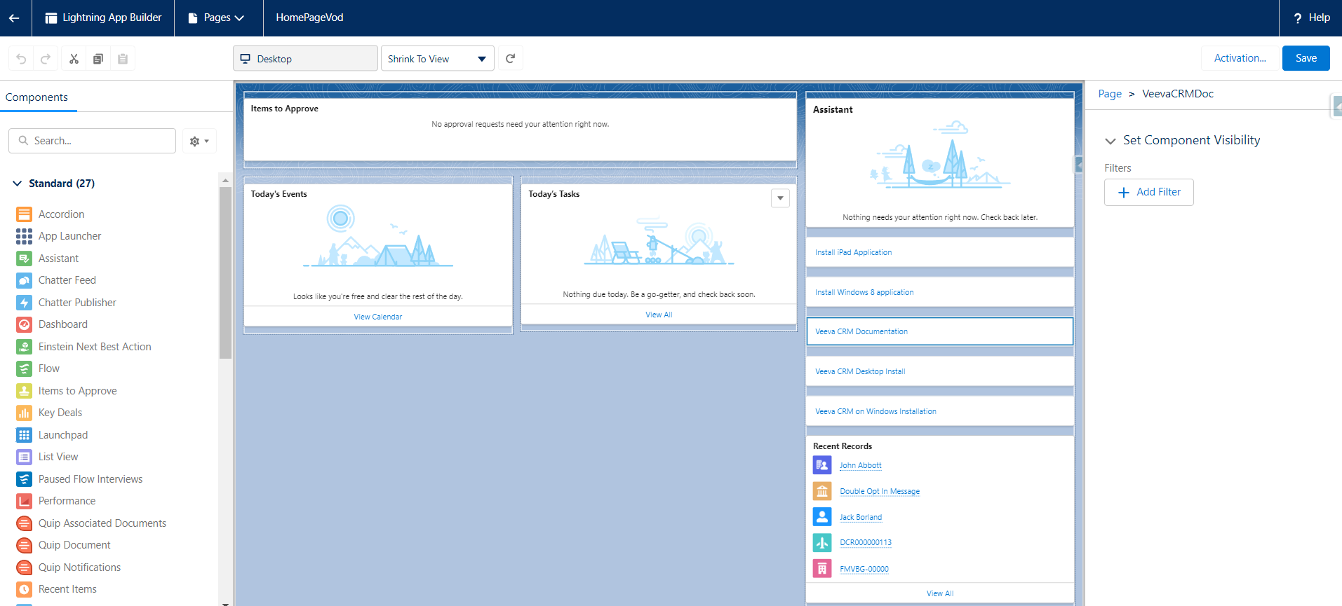
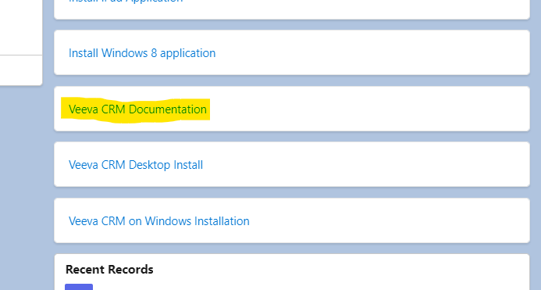
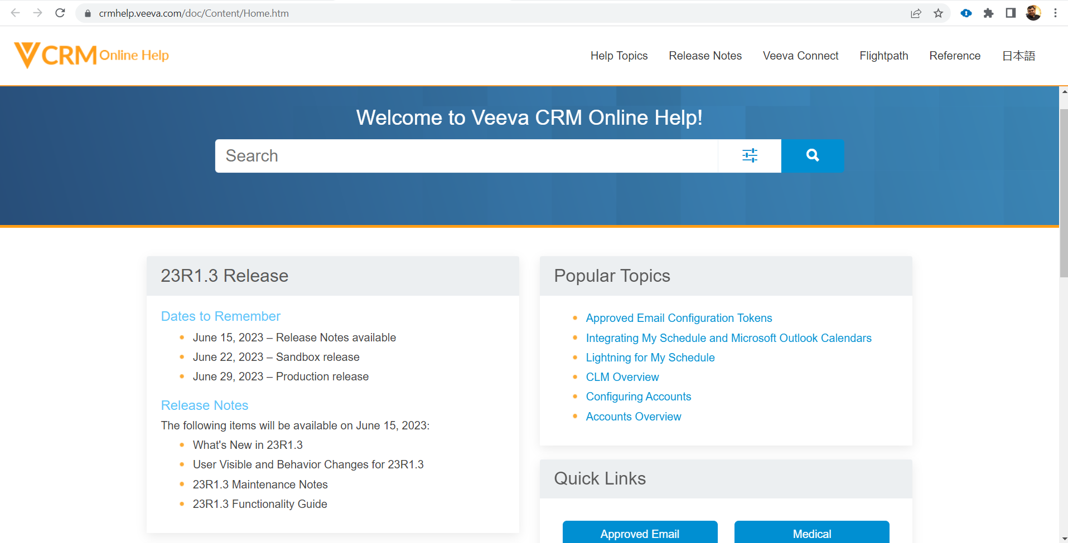
VEEVA CRM Online Help
  Enable Access:
    Enable the VEEVA CRM Help online documentation access from the home page.
    Home> Setup(Gear Icon)>Edit Page

Slide 15
Online Application UI Settings
Company Logo

Slide 16
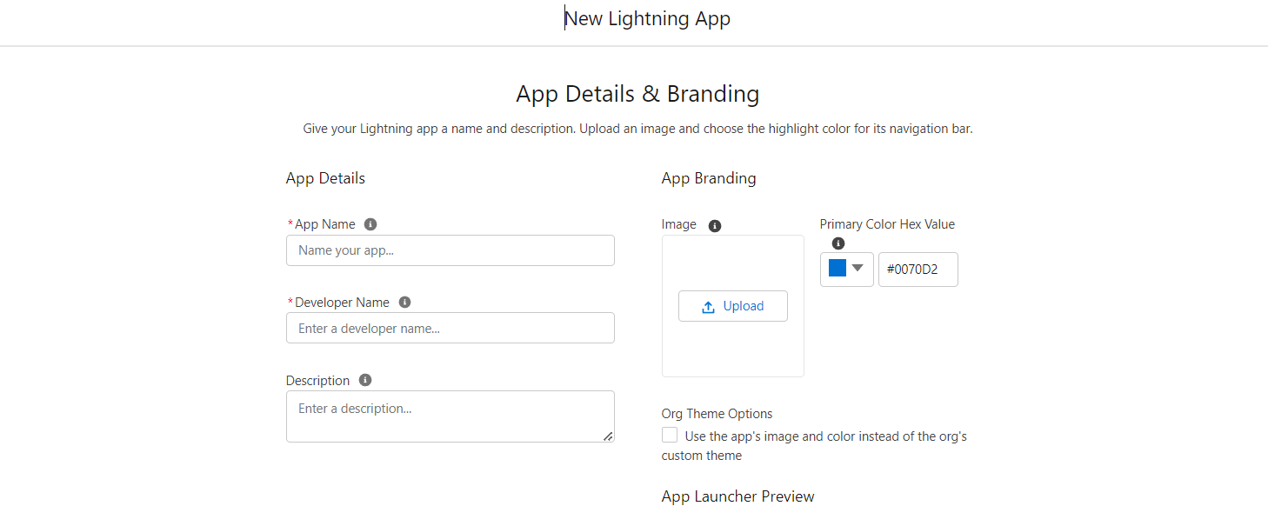
Company Logo
  To create a custom company logo:
    Upload the custom logo image into a folder through
  All Tabs > Documents
    Insert the logo image into the VEEVA CRM application:
  Setup > Create > Apps > Click the Edit link for the VEEVA CRM application

Slide 17
Online Application UI Settings
Search Features

Slide 18
Search- Overview
Salesforce.com provides five types of searches:
  Sidebar Search
  Advanced Search
  Standard Lookup Search
  Enhanced Lookup Search
  Global Search

Slide 19

Search- Sidebar Search
Sidebar Search features:
  Searches only a subset of records and fields, namely:
    Name, phone, email, external ID, and standard address fields (not VEEVA)
  Searches conducted as phrase searches
    Searching for “bob jones” returns items with Bob Jones, but not Bobby Jones or Bob T Jones
  Use the * (asterisk) and? (question mark) wildcard to refine results
    “*” is automatically appended to search value
Note:
  Chatter must be disabled to enable Sidebar Search

Slide 20
Search- Advanced Search
Advanced Search features:
  Searches in almost all records and fields, namely:
    Custom fields and attachments
    Long text fields such as notes, descriptions, and comments
  Search terms are treated as separate words
    “Bob Jones” returns items with Bob Jones, as well as an account named Bob Smith whose email address is bsmith@jones.com
  Supports wildcards * and? As well as operators such as AND, OR, and NOT
  Note:
    Chatter must be disabled to enable Sidebar Search

Slide 21
Search- Global Search
Global Search features:
  Similar to Advanced Search
  Can search more objects than Sidebar Search and Advanced Search, namely:
    Articles, documents, products, solutions, and Chatter feeds
    Files, groups, and people
  Note:
    Only Global search option is available,once Chatter button/menu is enabled (Sidebar Search feature becomes unavailable)

Slide 22
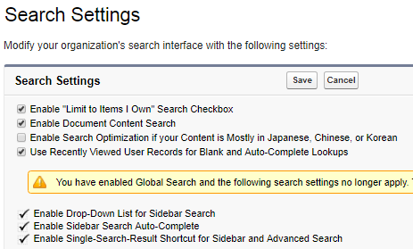
Search Configuration
To configure Search Settings, go to:
  Setup > Customize > Search > Search Settings

Slide 23
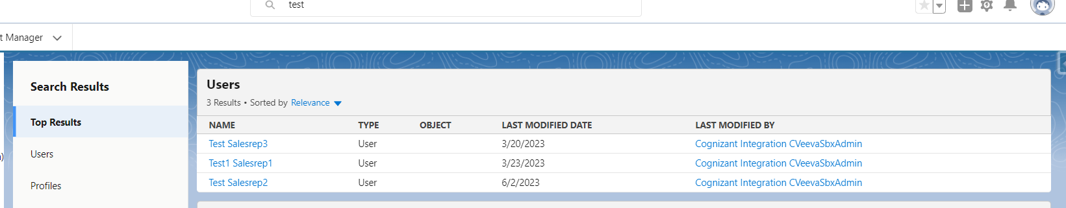
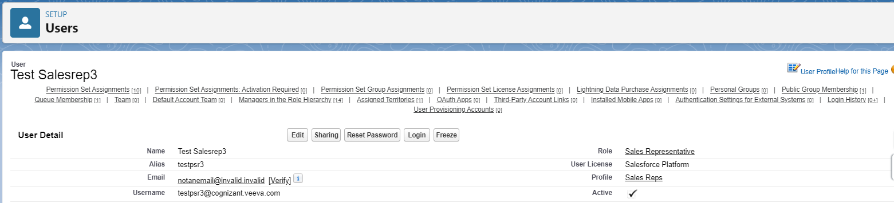
Search Results Layout
  Configure Search Results Layout:
    Search results page layouts are configured per object
    To configure a search results page layout, go to:
      Setup > Create > Object > [Object] > Search Layouts section
      Add fields to display in the relevant Search Results page layout

Slide 24
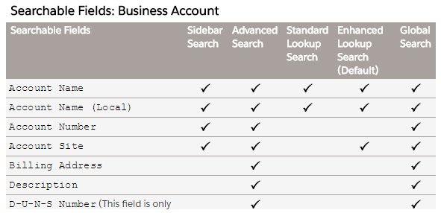
Search Feature – More Details
Refer Salesforce Online to Help for more details
  https://help.salesforce.com/apex/HTViewHelpDoc?id=search_fields.htm&language=en

Slide 25
Online Application UI Settings
Translation Workbench

Slide 26

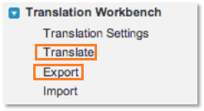
Translation Workbench
  Allows you to translate customizations made to the VEEVA org. Go to:
      Setup > Admin Setup > Translation Workbench
  Ability to choose language and select Translators among users:
      Language packs have to be deployed into orgs
      User Permission: Manage Translation (defaulted for Admin profile)
  Salesforce provides two options for Translations:
      Straight from the UI (Translate)
      Exporting components/Editing files/Importing

Slide 27
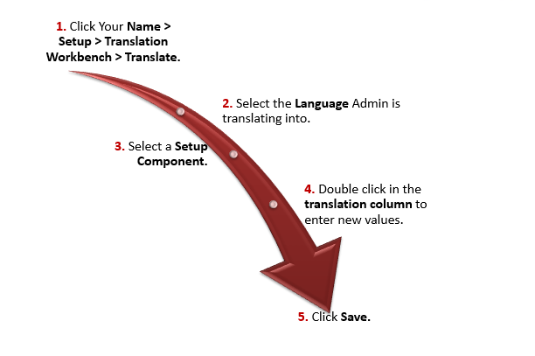
Translating from the UI

Slide 28
Search- Global Search
Three Types of Translation files can be exported from VEEVA CRM
Source
Creates .stf file with all the translatable labels.
Content will be in the org’s default language.
Used for first translation.
Untranslated
Creates .zip folder with several .stf files.
Filters labels and only exports untranslated labels.
Bilingual
Creates .zip with several .stf files
All the labels in their current form (translated or not)
Used for reviewing/editing translations

Slide 29
Working on Translation Files
Create one copy of Source for every language you translate into:
  Change header with appropriate country code (fr, de, es…)
Do not add / remove columns from file
Do not change file extension:
  .stf is the standard salesforce translation format
  The files can be edited in a text editor (i.e. Notepad) or in Excel
    Warning: Excel may corrupt your files by adding quotation marks for entries that contain a comma

Slide 30
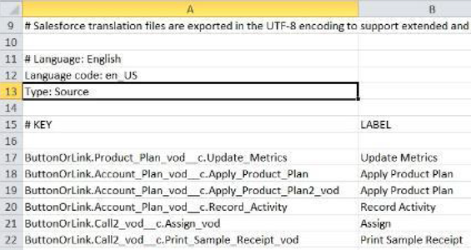
Importing Translated Files
Create 1 file
for each
language
Add language
attribute
(code)
Select files (or zip)
Upload
Key Considerations-
File size limit is 5MB for one upload.
      Several uploads can be done if needed
      After the import is complete:
        Labels get updated
        Confirmation email sent

Slide 31
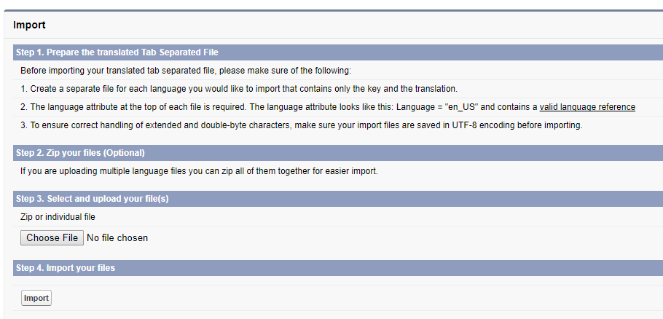
Importing Translated Files
Choose translated file
Import to load translation
After the import is complete:
  The labels are updated with the translations.
  A confirmation email is sent to the email address specified in your profile.
Verify the imported changes have been implemented. You can:
  Check labels in your Salesforce organization.
  Check labels through the Translation Workbench.

Slide 32
Importing Translated Files
Choose translated file
Import to load translation
After the import is complete:
  The labels are updated with the translations.
  A confirmation email is sent to the email address specified in your profile.
Verify the imported changes have been implemented. You can:
  Check labels in your Salesforce organization.
  Check labels through the Translation Workbench.

Slide 33
Online Application UI Settings
Tab Names & Labels

Slide 34

Changing Tab Names & Labels
Tab Names and labels-
  Edit tabs names & labels to better match your organization’s terminology
    User Permissions: ‘Customize Application’ or ‘View Setup and Configuration’
  Go to Setup > Customize > Tab Names and Labels > then rename Tabs and Labels
      Key Considerations
        Not all tabs can be renamed
        Best Practice: Do not rename VEEVA Tabs (i.e. My Accounts)
        You may need to manually update other items: list view names, report types, Record Types that contain the original name

Slide 35
Check Your Understanding ... 1
1. Which search option will be available to the users, if Chatter is enabled?
Global Search
Siderbar Search
Answer: Global Search

Slide 36
Check Your Understanding ... 2
2. 'Enable the Salesforce Classic 2010 User Interface Theme’ option in the User Interface section is used to _____.
Enable the updated UI
Enable the updated Theme
Answer: Enable the updated UI

Slide 37
Check Your Understanding ... 3
3. When using record types (for any object), you should always use the un-translated label, not the API name.
State True or False.
True
False
Answer: True

Slide 38
Check Your Understanding ... 4
4. The VEEVA Message object requires users to have _____ access to the VEEVA Message object and all it's fields.
Read
Write
Execute
Read/Write
Answer: Read

Slide 39
Check Your Understanding ... 5
5. Change in UI Settings only apply to online application not iRep or vMobile Tablet.
State True or False
True
False
Answer: True

Slide 40

Summary
In this module, you have learnt to:
  Explore User Interface Settings
  Discuss Searching
  Customize Home Tab Page Layout

